Slide 1
Microsoft Power Platform

Slide 2
Day 2: Power Packed Day with Power Automate – Part II

Slide 3

Agenda
Introduction
Types of Power Automate
Data types and expression
Working with Arrays
Control flow and action settings
Demo

Slide 4
Get started with Power Automate

Slide 5
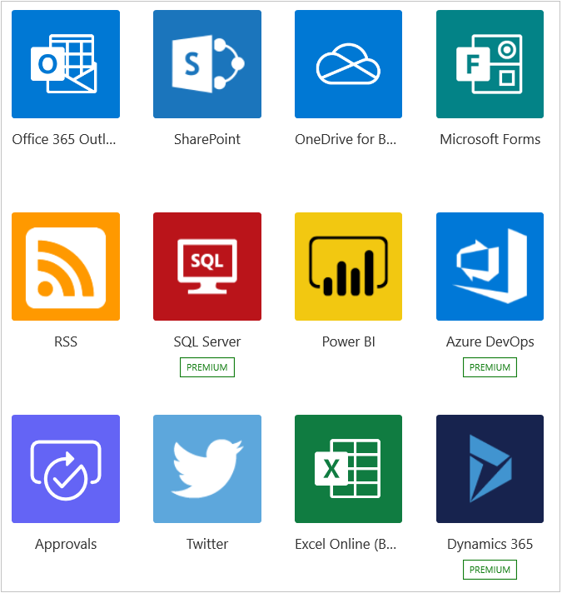

Introduction to Power Automate

Slide 6
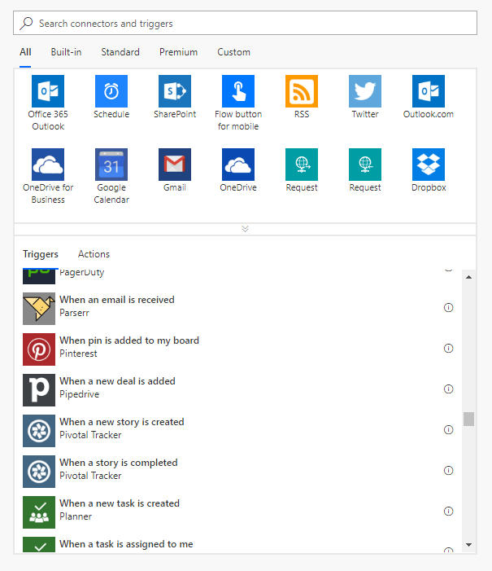
Types of Power Automate
Scheduled flows
Automated flows
Instant flows
Business process flows

Slide 7
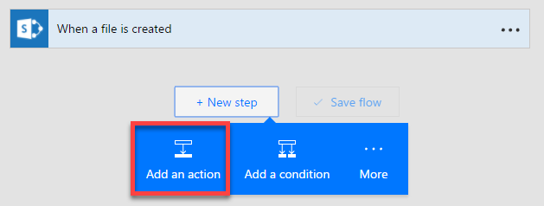
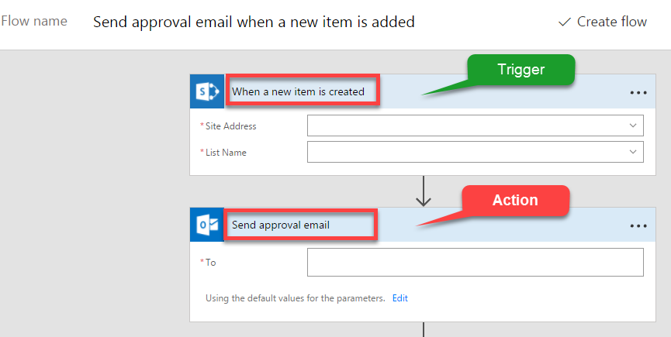
Flow Components
Three major components
Triggers
Actions
Conditions

Slide 8
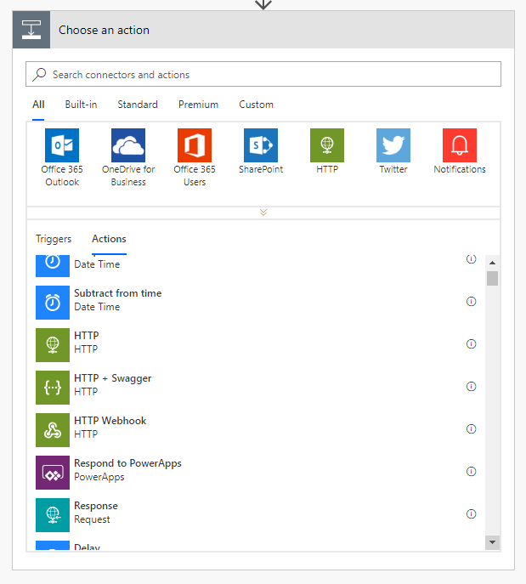
Actions in flows
1+ steps that run after the trigger
Connect to cloud service or on-prem via the on-prem data gateway
Directly connect to HTTP endpoints if there’s no out-of-box connector
Some actions may not even use connections – just manipulate data locally
Custom connectors connect to your own cloud or on-prem REST services

Slide 9
Flowing data
Trigger
Outputs:
File name
Size
File content
Data ‘flows’ from each step and is available for all later steps
Use Add Dynamic Content to select outputs from previous steps
Input types are matched to output types to show a subset of outputs by default
Expressions can be used to convert between data types or calculate derived values
Action 1
A binary field would see:
File name
Size
File content
Outputs:
Title
Count
Action 2
A string field would see:
A number field would only see:
File name
Size
File content
Count
Title
Size
Count

Slide 10
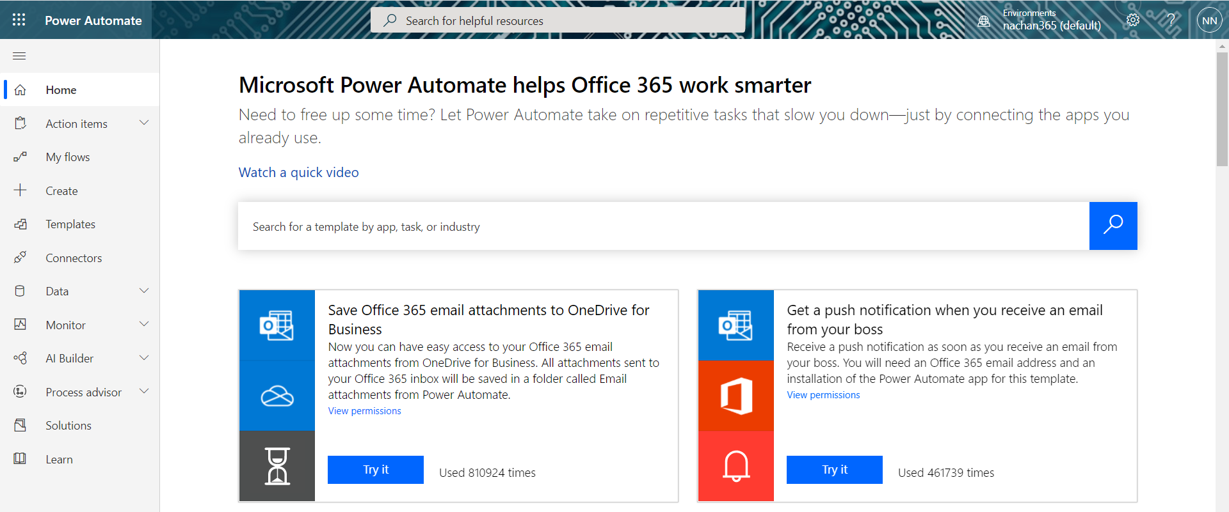
A brief tour of Power Automate

Slide 11
Create your first flow

Slide 12
Power Automate Desktop flow

Slide 13
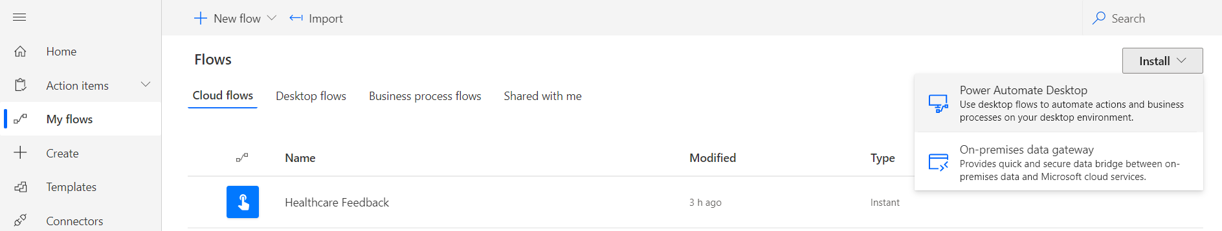
Software installation

Slide 14
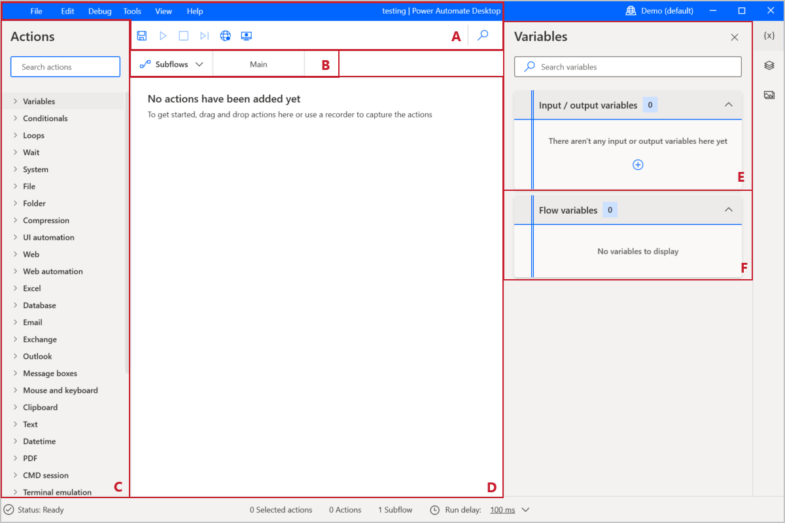
Explore Power Automate Desktop

Slide 15
Create your first Power Automate Desktop flow

